Slide 1




Collections

Slide 2

Overview
Introduction
What is collection?
Defining Collections
.NET Collections
System.Collections
Generic or Non-Generic
ArrayList
HashTable
Queue
Stack Class
SortedList Class
List<T>
Dictionary<TKey, TValue>
SortedList<TKey, TValue>
Queue<T>
Stack<T>
Create a Custom Collection
Advantages of Generics

Slide 3

Introduction
A collection is a kind of data structure.
A data structure is a way of storing data in a computer so that it can be used efficiently.
Collections can improve code readability and self documentation, as well as enhance maintainability.
C# Collection classes are defined as part of the System.Collections .

Slide 4
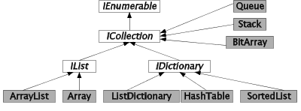
What is collection?
A collection — sometimes called a container — is simply an object that groups multiple elements into a single unit.
Data can be handled more efficiently when grouped together
Most collection classes derive from the interfaces

Slide 5
Types of Collections in .NET
Two type
  Non-Generic Collections using System.Collections
  Generic Collections using System.Collections.Generic
Non-Generic | Similar Generic Type
ArrayList | List<T>
Hashtable | Dictionary<TKey,TValue>
SortedList | SortedList<TKey,TValue>
Queue | Queue<T>
Stack | Stack<T>
Note: <T> refers to data type

Slide 6
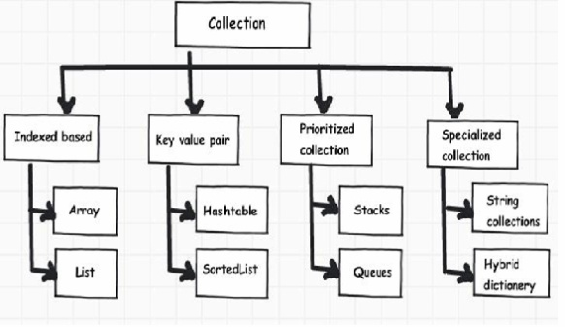
.NET Collections
Divided in to four important categories

Slide 7
Non Generic Collections

Slide 8

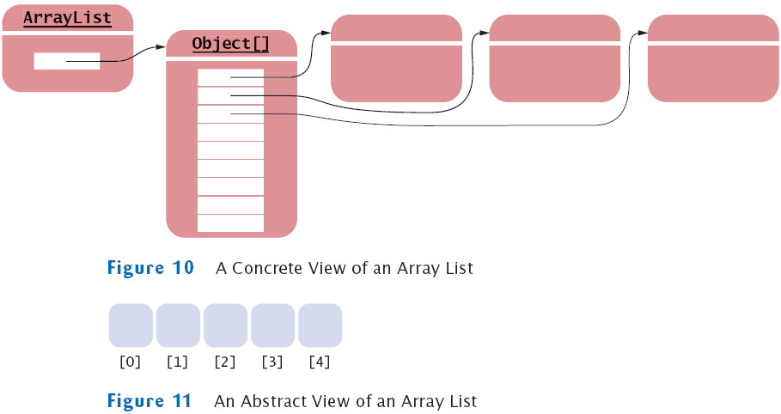
ArrayList
ArrayList is very flexible Data Structure from C sharp Collection.
ArrayList's will grow dynamically and also shrink .
ArrayList can hold any type of data type like integer, string, structures, objects etc.

Slide 9
ArrayList
Three main operations can be performed on a ArrayList and its elements:
  Add : Add an Item in an ArrayList
  Insert : Insert an Item in a specified position in an ArrayList
  Remove : Remove an Item from ArrayList
  RemoveAt: remove an item from a specified position
  Sort : Sort Items in an ArrayList.
  Capacity - Gets or sets the number of elements that the ArrayList can contain.
  Count - Gets the number of elements contained in an ArrayList object.

Slide 10
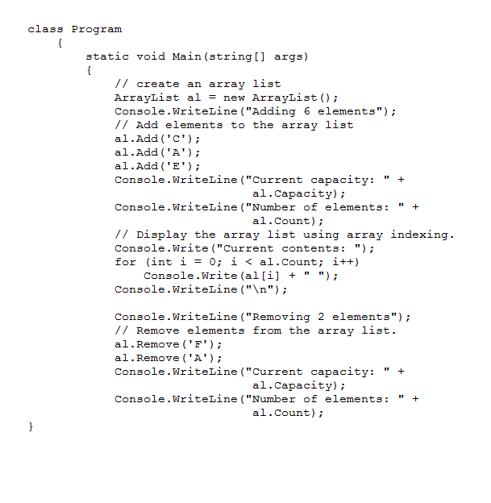

ArrayList
Capacity
Count
Add(value)
Sort
Insert

Slide 11




HashTable
HashTable in C# represents a collection of key/value pairs which maps keys to value.
Any non-null object can be used as a key but a value can.
We can retrieve items from HashTable to provide the key .
When an element is added to the HashTable, the element is placed into a bucket based on the hash code of the key.
The Hash Code is generated by the IHashCodeProvider interface

Slide 12
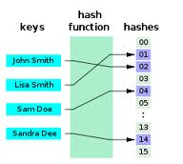
HashTable
The capacity of a HashTable is the number of elements the HashTable can hold.
Elements are added to a HashTable, the capacity is automatically increased as required through reallocation.
The commonly used functions in Hashtable are :
  Add : To add a pair of value in HashTable
  ContainsKey : Check if a specified key exist or not
  ContainsValue : Check the specified Value exist in HashTable
  Remove : Remove the specified Key and corresponding Value

Slide 13
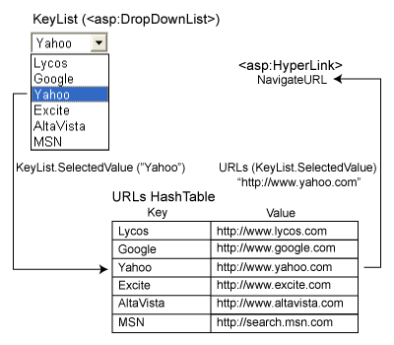
HashTable

Slide 14
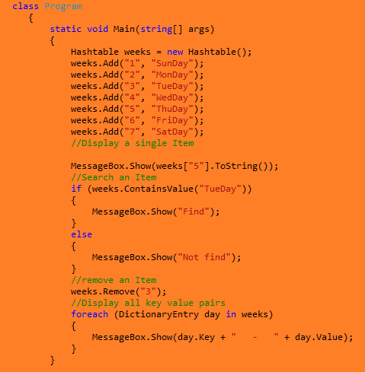
Example

Slide 15

HashTable Methods
Add
Clear
ContainsKey
ContainsValue
GetHashCode
Remove
ToString

Slide 16

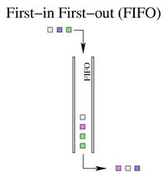

Queue
The Queue class represents a way of managing elements in a collection using the First In First Out (FIFO) technique for adding and removing elements.
Use Queue if you need to access the information in the same order that it is stored in the collection.

Slide 17

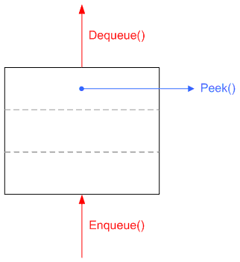
Queue
Three main operations can be performed on a Queue and its elements:
  Enqueue adds an element to the end of the Queue.
  Dequeue removes the oldest element from the start of the Queue.
  Peek returns the oldest element that is at the start of the Queue but does not remove it from the Queue.

Slide 18
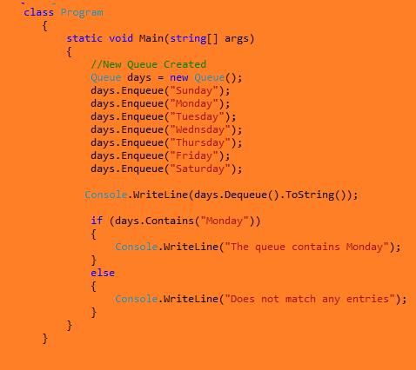

Sample Code

Slide 19
Queue Methods
Count
Contains()
Dequeue()
Enqueue()
Peek()

Slide 20

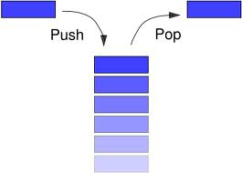

Stack Class
The Stack class represents a way of managing elements in a collection using the Last In First Out (LIFO) technique for adding and removing elements.
Three main operations can be performed on a stack and its elements:
    Push inserts an element at the top of the Stack.
    Pop removes an element from the top of the Stack.
    Peek returns an element that is at the top of the Stack but does not remove it from the Stack
    Contains: Check the object contains in the Stack

Slide 21
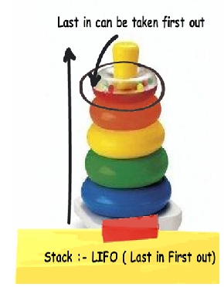
Stack Class Methods
Properties
Count
Methods
Push(element)
Pop()
Peek()

Slide 22
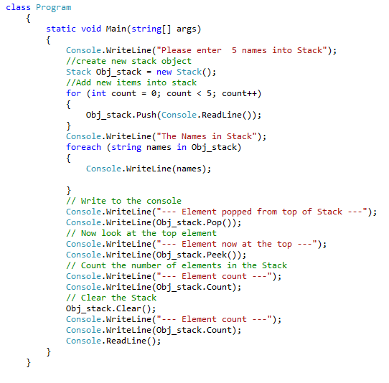
Stack Example

Slide 23


SortedList Class
Represents a collection of key/value pairs that are sorted by the keys and are accessible by key and by index.
A SortedList object internally maintains two arrays to store the elements of the list;
    One array for the keys
    One for array for the associated values.
A key cannot be a null reference, but a value can be.
A SortedList object automatically sort the items in alphabetic or numeric order.

Slide 24
SortedList Class
SortedList is a combination of the Array and the Hashtable.
Access items in a SortedList by the index (like the Array), or by the key (like the Hashtable).
SortedList allowing efficient indexed retrieval.
When an element is added or Removed from SortedList, SortedList in the correct sort order, and the indexing adjusts accordingly.
The index of a specific key/value pair might change as elements are added or removed from the SortedList object.

Slide 25
SortedList Class
The main operations can be performed on a SortedList and its elements:
  Add(key,value):Adds an element with the specified key and value to a SortedList .
  Count:Gets the number of elements contained in a SortedList.
  Capacity - Gets or sets the capacity of a SortedList object.
  Keys - Gets the keys in a SortedList object.
  Values - Gets the values in a SortedList object.

Slide 26
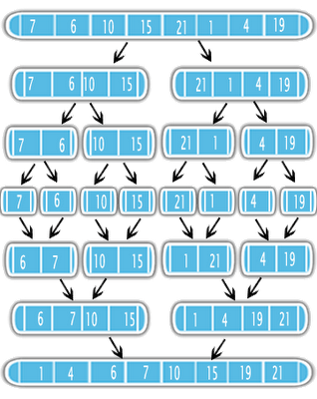
SortedList Methods
Properties
  Capacity
  Count
  Keys
  Values
Methods
  Add(key,value)

Slide 27
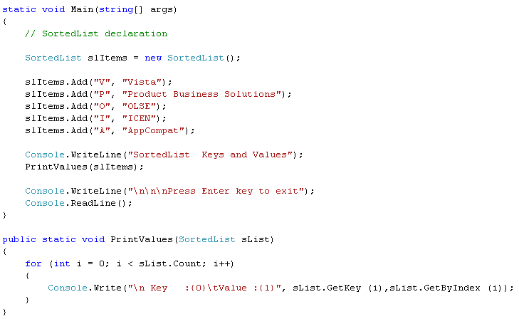
SortedList Example

Slide 28
System.Collection.Generic

Slide 29

List<T>
The List<T> class is the generic equivalent of the ArrayList class.
You need to use < and > in the List declaration
List<T> is a generic class in the System.Collections.Generic Namespace.
An instance of this class is basically a strongly typed arraylist.
The List<T> is not guaranteed to be sorted.
Type Parameters
T
  The type of elements in the list.
List<int> list = new List<int>();

Slide 30
List<T>
  The List<T> class uses both an equality comparer and an ordering comparer.
  Methods such as Contains, IndexOf, LastIndexOf, and Remove use an equality comparer for the list elements.
  Methods such as BinarySearch and Sort use an ordering comparer for the list elements.

Slide 31
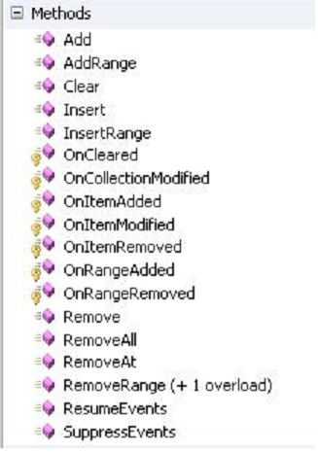
List<T> methods

Slide 32
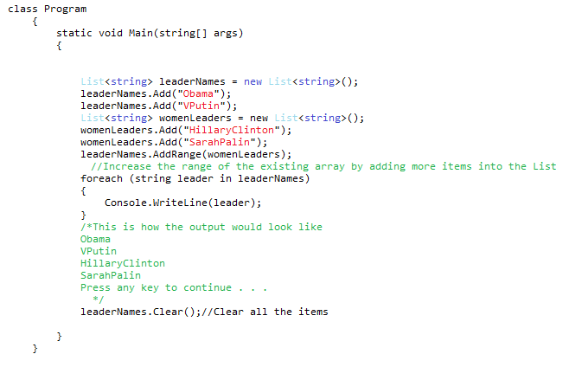
Example

Slide 33


Dictionary<TKey, TValue>
  The Dictionary<TKey, TValue> generic class provides a mapping from a set of keys to a set of values.
  Every key in a Dictionary<TKey, TValue> must be unique.
  As elements are added to a Dictionary<TKey, TValue>, the capacity is automatically increased as required by reallocating the internal array.

Slide 34

Dictionary<TKey, TValue>
Dictionary<string, int> d = new Dictionary<string, int>();
Type Parameters
Tkey
  The type of the keys in the dictionary.
Tvalue
  The type of the values in the dictionary.

Slide 35
Dictionary Methods and Properties
Methods
  Add()
  ContainsKey()
  ContainsValue()
Properties
  Count
  Key
  Value

Slide 36
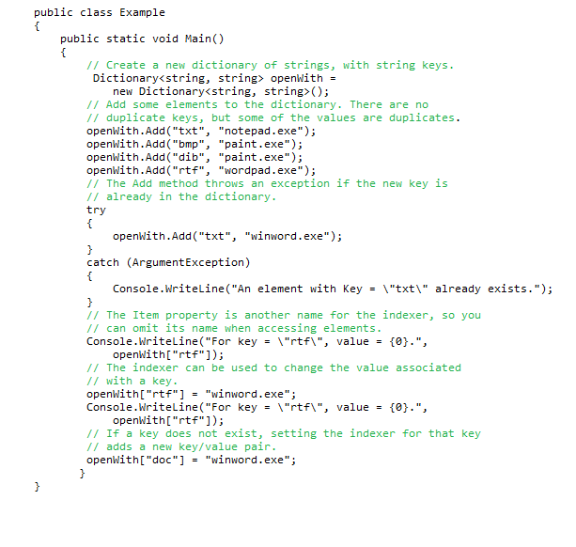
Example

Slide 37
SortedList<TKey, TValue>
The SortedList<TKey, TValue> generic class is an array of key/value pairs.
Sorted by the key
A SortedList can support multiple readers concurrently,
Every key in a SortedList<TKey, TValue> must be unique.
A key cannot benull, but a value can be, if the type of values in the list, TValue, is a reference type.

Slide 38

SortedList<TKey, TValue>
Type Parameters
  Tkey
    The type of keys in the collection.
  Tvalue
    The type of values in the collection.
SortedList<TKey, TValue> uses less memory than SortedDictionary<TKey, TValue>.
SortedList<TKey, TValue> supports efficient indexed retrieval of keys and values through the collections returned by the Keys and Values properties

Slide 39
SortedList<TKey, TValue>Methods and Properties
Properties
  Capacity
  Count
  Keys
  Values
Methods
  Add()
  ContainsKey()
  ContainsValue()
  GetKey()
  Remove()

Slide 40
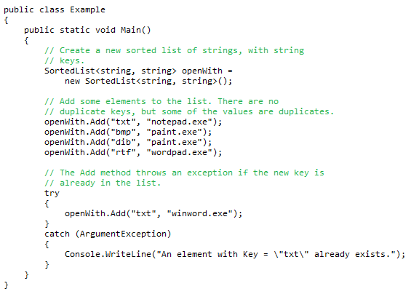
Example SortedList<TKey, TValue>

Slide 41


Queue<T> Class
Queues are useful for storing messages in the order they were received for sequential processing.
Objects stored in a Queue<T> are inserted at one end and removed from the other.
Type Parameters
  T
    Specifies the type of elements in the queue.

Slide 42
Methods and properties by the Queue<T> class.
Properties
  Count
Methods
  Contains
  Dequeue
  Enqueue
  Peek

Slide 43
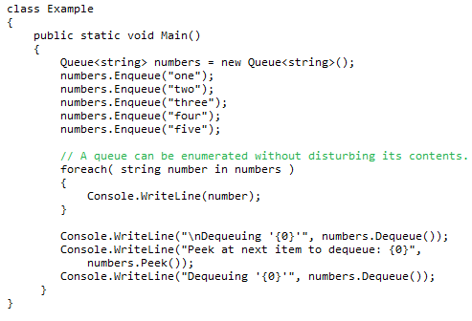
Example

Slide 44
Stack<T> Class
Stack<T> is implemented as an array.
Represents a variable size last-in-first-out (LIFO) collection of instances of the same arbitrary type.
Type Parameters
  T
    Specifies the type of elements in the stack.

Slide 45
Methods and properties by the Stack<T> class
Properties
  Count
Methods
  Push
  Pop
  Peek

Slide 46
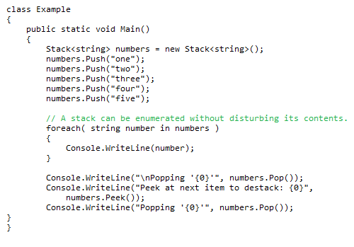
Example

Slide 47
System.Collections.Specialized NameSpace
Even more collection classes are provided by the .NET Framework.
Some collections and helper classes that extend the collections of the System.Collections namespace and can be used in specific situations.
  ListDictionary Class
  HybridDictionary Class
  NameValueCollection Class
  NameObjectCollectionBase Class
  StringCollection Class
  StringDictionary Class
  CollectionsUtil Class

Slide 48
Advantages of Generics
The generics feature shifts the burden of type safety from you to the compiler.
There is no need to write code to test for the correct data type because it is enforced at compile time.
The need for type casting and the possibility of run-time errors are reduced.
Generic collection types generally perform better for storing and manipulating value types because there is no need to box the value types.
Boxing is when you "convert" a value type to a reference type, and unboxing is when you "convert" a reference type to a value type.

Slide 49
Advantages of collection classes
Collection classes
  Enable programmers to store sets of items by using existing data structures.
    Need not concern how they are implemented.
  Example of code reuse.
  Programmers can code faster and expect excellent performance
  maximizing execution speed and minimizing memory consumption.

Slide 50

Selecting a Collection Class
Which one is best?
  No definite best one but most appropriate.
  Your choice should be based on your needs.
  Be sure to choose your collection class carefully. Using the wrong type can restrict your use of the collection.

Slide 51


Tips
Do you need a sequential list where the element is typically discarded after its value is retrieved?
  If yes, consider using the Queue class or the Queue generic class if you need first-in-first-out (FIFO) behavior.
  Consider using the Stack class or the Stack generic class if you need last-in-first-out (LIFO) behavior.
  If not, consider using the other collections.

Slide 52
Tips
Do you need to access the elements in a certain order, such as FIFO, LIFO, or random?
  The Queue class and the Queue generic class offer FIFO access.
  The Stack class and the Stack generic class offer LIFO access.
  The LinkedList generic class allows sequential access either from the head to the tail or from the tail to the head.
  The rest of the collections offer random access.

Slide 53
Tips
Do you need to access each element by index?
  Access elements by Zero based index of elements: ArrayList,StringCollection and List Generic Class.
  Access Elements by the Key of elements:HashTable,SortedList,Dictonary

Slide 54
Tips
Do you need collections that accept only strings?
  StringCollection (based on IList) and StringDictionary (based on IDictionary) are in the System.Collections.Specialized namespace.
  In addition, you can use any of the generic collection classes in the System.Collections.Generic namespace as strongly typed string collections by specifying the String class for their generic type arguments.
Do you need fast searches and retrieval of information?
    ListDictionary is faster than Hashtable for small collections (10 items or fewer). The SortedDictionary generic class provides faster lookup than the Dictionary generic class.

Slide 55
Tips
Do you need to sort the elements differently from how they were entered?
    The Hashtable class sorts its elements by their hash codes.
    The SortedList class and the SortedDictionary and SortedList generic classes sort their elements by the key,
    ArrayList provides a Sort method that takes an IComparer implementation as a parameter.

Slide 56
Tips
Will each element contain one value, a combination of one key and one value, or a combination of one key and multiple values?
  One value: Use any of the collections based on the IList interface or the IList generic interface.
  One key and one value: Use any of the collections based on the IDictionary interface or the IDictionary generic interface.
  One value with embedded key: Use the KeyedCollection generic class.
  One key and multiple values: Use the NameValueCollection class.

Slide 57

Summary
The .NET Framework class library contains several new generic collection classes in the System.Collections.Generic namespace.
By now you should have a pretty good understanding of collections in the .NET Framework,
what they are and when
why you would want to use them.
Collections can be a powerful tool in your programming arsenal so it’s important to know when they will benefit you and how to use them wisely

Slide 58


Slide 59

Reference link
http://msdn.microsoft.com/en-us/library/system.collections.aspx
http://msdn.microsoft.com/en-us/library/ms172181.aspx
http://msdn.microsoft.com/en-us/magazine/cc163670.aspx
http://msdn.microsoft.com/en-us/magazine/cc163377.aspx

